Slide 1
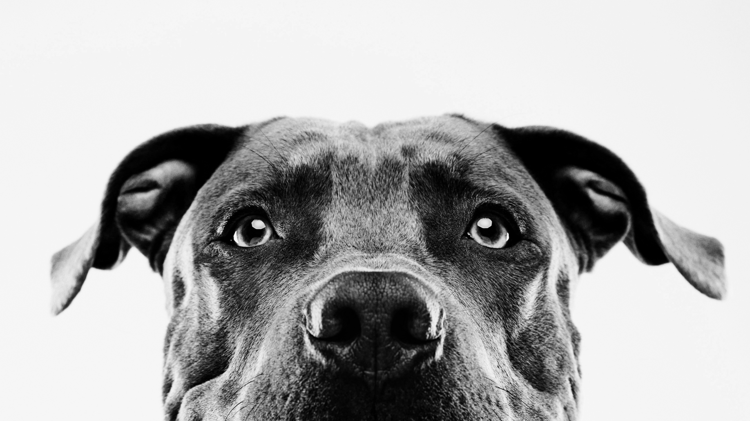
Germany: Who Let The Dogs Out?
Wasinee siewsrichol

Slide 2

How Do We Help Clear the Shelters?

Slide 3


Who Owns the Dogs?
69%
31%

Slide 4
Most Popular Breed
Mischling Klein = 620
Chihuahua = 516
Labrador Retriever = 439
Yorkshire Terrier = 298
Jack Russel Terrier = 290
Out of 7155 Dogs

Slide 5
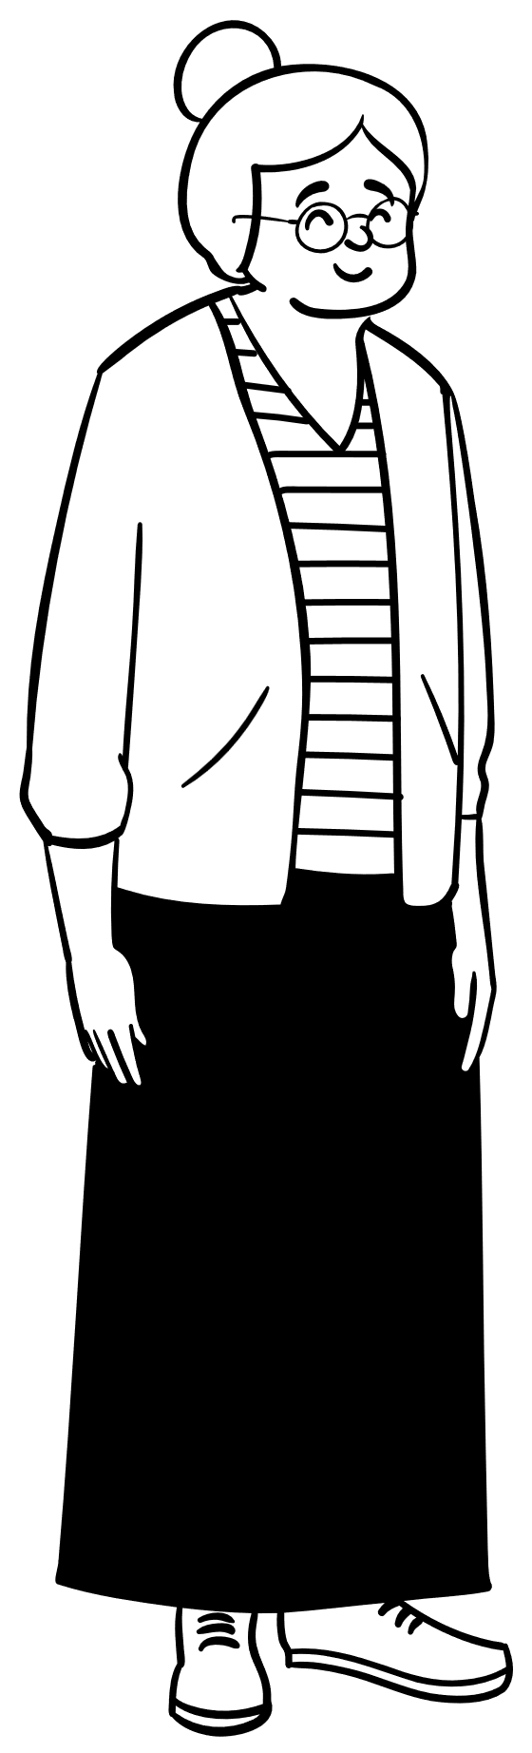
What Age?
51-60 22%
41-50 21%
31-40 19%
61-70 14%
21-30 11%

Slide 6

Dog Shelters
About 550 animal shelters
More than 100,000 dogs end up here every year and usually stay for the rest of their lives

Slide 7
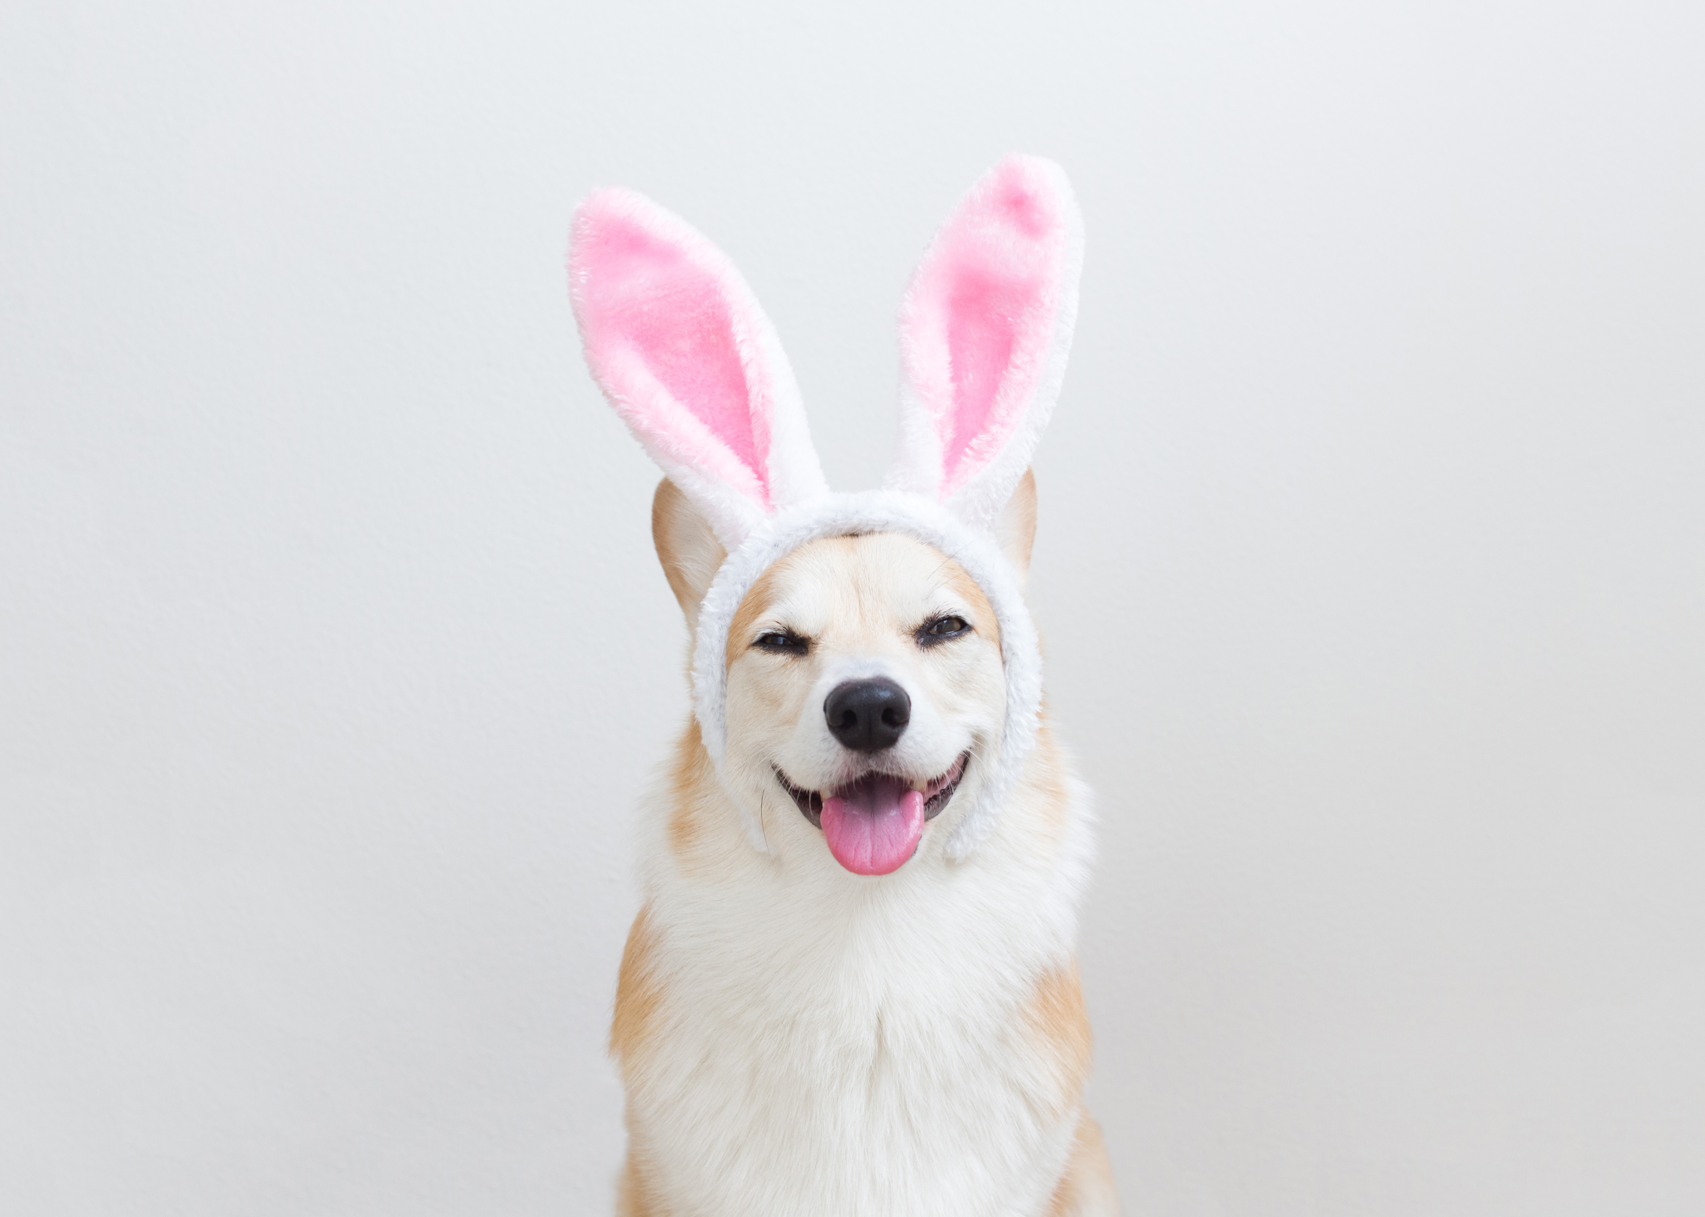
Conclusions
Women 69%
Mischling Klein
Age 41-60 = 42%
550 Shelters (Mostly Private)
100,000 Dogs in Shelters

Slide 8
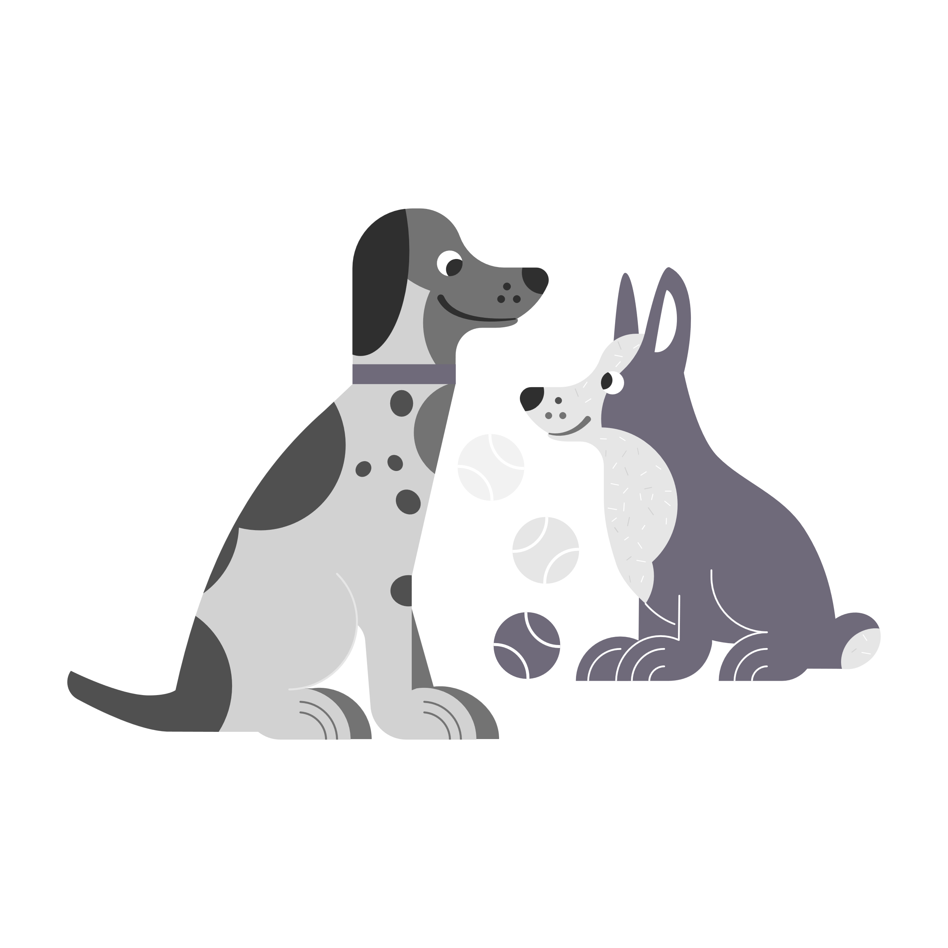
SMART Goals
How to target more men?
How to diversify dog owner breeds?
How to target people under 40 years old?

Slide 9
Who Let The Dogs Out: WE DO!

